Slide 1

Glance 2.0
ICG | Rates
Summer Analyst Presentation | 7/22/18
Summer Analyst – Rates
Mandy Hsu, Vincent Taylor, Tahiya Chowdhury
July 23rd, 2018
Strictly Private and Confidential

Slide 2
Agenda
About Us
Our Assignment
Snapshots
Our Technology
Challenges/Solutions
Impact
Q/A

Slide 3
1. About Us

Slide 4
Rates – ICG Technology
Our Team
Mentors/Buddies
Sam Eberspacher
Vincent Taylor
Moshe Teitz
Mandy Hsu
Tenzing Passang
Tahiya Chowdhury
Rates Technology
Managers
Phillip Jung
Jonathan Elphick

Slide 5
G10 Rates Technology
G10 Rates
Mission: Generate revenue off client flow while prioritizing efficiency and safety
Products: securities like bonds, exchange traded derivatives (such as Eurodollar Futures), and over-the-counter(OTC) interest rate derivatives like swaps
E-trading – trading securities electronically
Trader Desktop: For pricing, risk and data analysis
IMM (Internal Market Making): Algo, Velocity trader tools, legger and etc
Distribution: Price streaming, RFQ, and Market connectivity
Pricing: Graphite for curves and pricing, swap curves
Notes:
G10 rates include G10 trading, G10 sales, Quants, MRM (market risk management) , PCG, Audit and other legal support team, and production support.
G10 rates tech itself has several departments: e-Trading, TPS (official trade capture service), MTFD (markets treasury finance desk), risk

Slide 6
2. Common Slides
2. Our Assignment

Slide 7
Rates – ICG Technology
Glance
How it worked
Primary Functions
Monitoring existing tools’ health status that are internal to rates
Participating Members
Glance
Tasks
MKV Fetch
Tasks
Web Server
Tasks
Glance 2.0
Our Changes
Primary Functions
Monitoring existing tools’ health status that are internal to rates
Participating Members
Glance 2.0
Ignite Cluster
Tasks
Web Server
Tasks
Notes:
Suggestive script: The competitive advantage that supports the bulk of the team’s fundamentals is stability, agility and experience. These three goals inspired our summer project, which is to take an existing functioning program, Glance, and upgrade it with a new backend for scalability and a new frontend for a better user experience.
So what is Glance? Glance is a user-facing web-based dashboard based on Grails, Groovy, and Javascript designed for monitoring the health of the Rates platform. Glance was originally intended to be used with MkvPythonMonitor and/or MkvFetch to provide a user-friendly view of python checks for UAT and production surveying. Now we are trying to scale the number of checks that Glance can perform by switching our backend to Apache Ignite, which increases the performance through distributive memory.

Slide 8
3. Snapshots

Slide 9
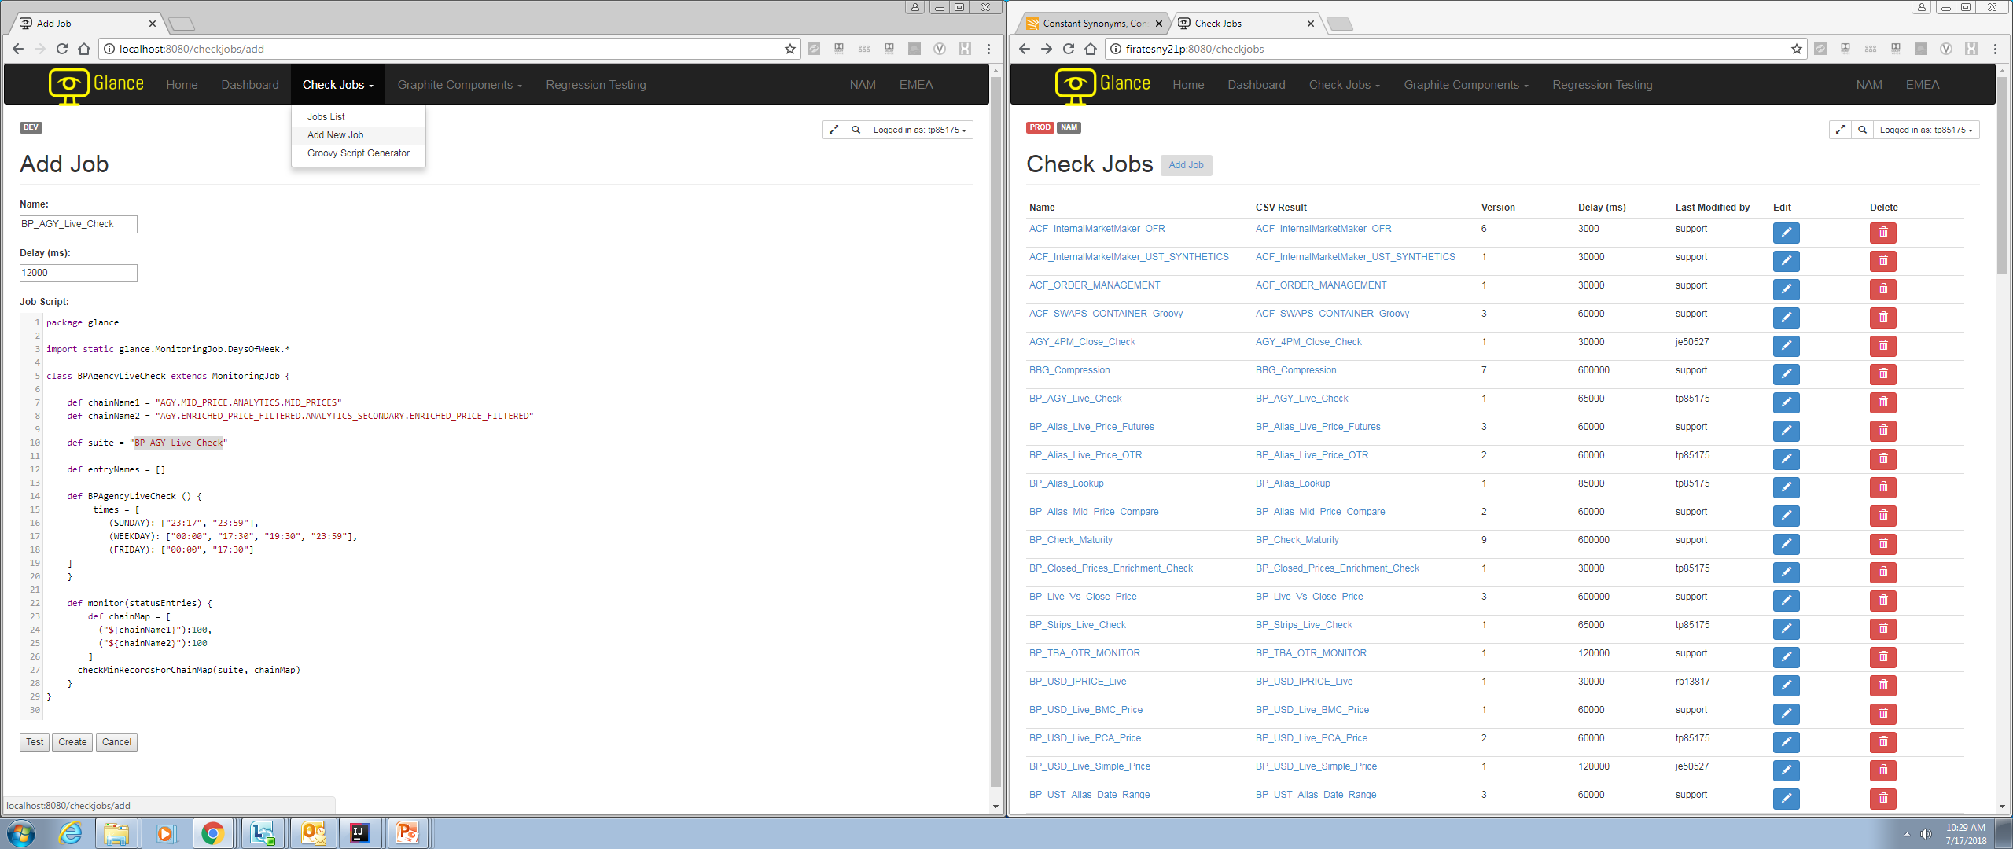
Glance Snapshots
Creating a check job from start to finish:
3
Text and Layouts
Notes:
To show a simple demonstration of how the UI works, allow me to walk you through the makings of a check. From left to right, up to down you would see the general flow of creating one check. At this point, the target user, which are usually a software developer within Pricing, IMM, or distribution, would write down a check in groovy within Glance. All the data would be retrieved through our backend service, supported via Apache Ignite, and the computation of the logic itself is done within Glance. The user would proceed to create nodes to display the information computed with the data received. There are two types of nodes, the suite node itself contains all of the information returned during the computation, which you can see in the bottom left. The internal node provides the structure of all suite nodes based on what groups they are part of.

Slide 10
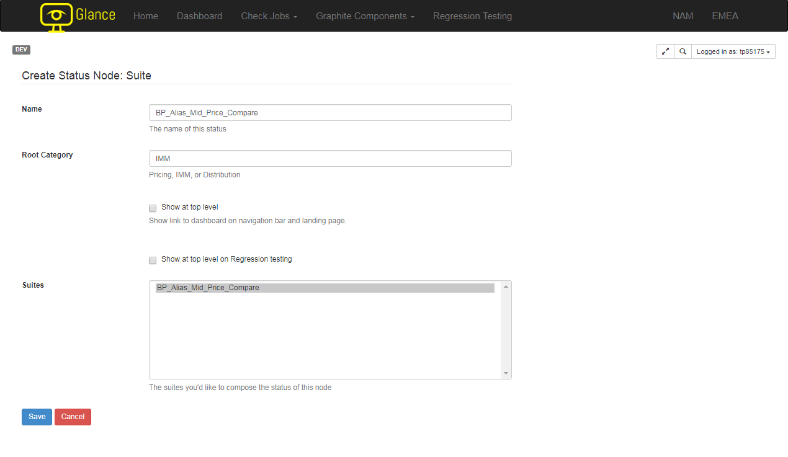
Glance Snapshots
Creating a check job from start to finish:
3
Text and Layouts
Notes:
To show a simple demonstration of how the UI works, allow me to walk you through the makings of a check. From left to right, up to down you would see the general flow of creating one check. At this point, the target user, which are usually a software developer within Pricing, IMM, or distribution, would write down a check in groovy within Glance. All the data would be retrieved through our backend service, supported via Apache Ignite, and the computation of the logic itself is done within Glance. The user would proceed to create nodes to display the information computed with the data received. There are two types of nodes, the suite node itself contains all of the information returned during the computation, which you can see in the bottom left. The internal node provides the structure of all suite nodes based on what groups they are part of.

Slide 11
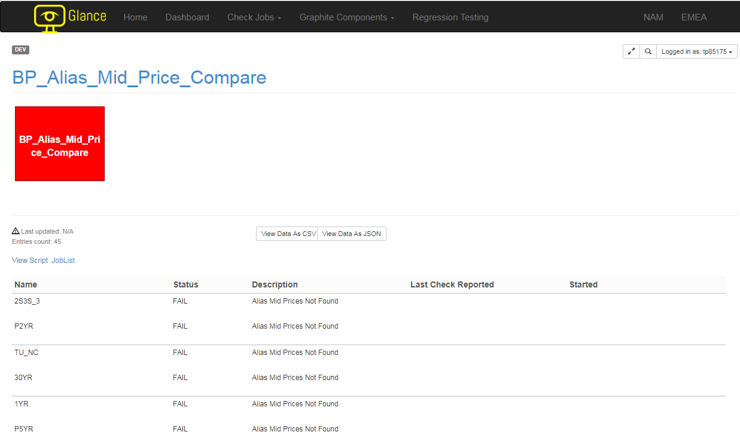
Glance Snapshots
Creating a check job from start to finish:
3
Text and Layouts
Notes:
To show a simple demonstration of how the UI works, allow me to walk you through the makings of a check. From left to right, up to down you would see the general flow of creating one check. At this point, the target user, which are usually a software developer within Pricing, IMM, or distribution, would write down a check in groovy within Glance. All the data would be retrieved through our backend service, supported via Apache Ignite, and the computation of the logic itself is done within Glance. The user would proceed to create nodes to display the information computed with the data received. There are two types of nodes, the suite node itself contains all of the information returned during the computation, which you can see in the bottom left. The internal node provides the structure of all suite nodes based on what groups they are part of.

Slide 12
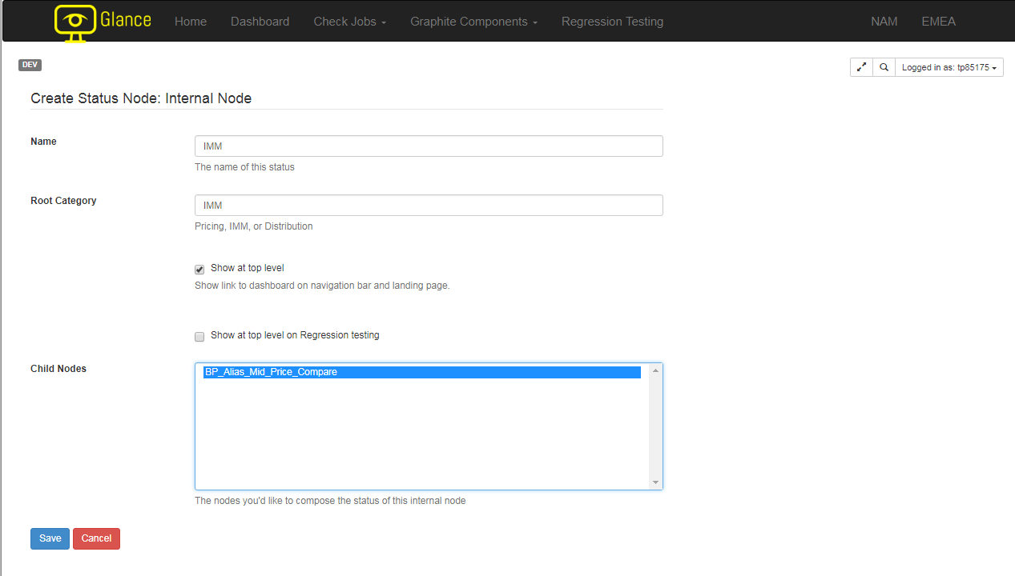
Glance Snapshots
Creating a check job from start to finish:
3
Text and Layouts
Notes:
To show a simple demonstration of how the UI works, allow me to walk you through the makings of a check. From left to right, up to down you would see the general flow of creating one check. At this point, the target user, which are usually a software developer within Pricing, IMM, or distribution, would write down a check in groovy within Glance. All the data would be retrieved through our backend service, supported via Apache Ignite, and the computation of the logic itself is done within Glance. The user would proceed to create nodes to display the information computed with the data received. There are two types of nodes, the suite node itself contains all of the information returned during the computation, which you can see in the bottom left. The internal node provides the structure of all suite nodes based on what groups they are part of.

Slide 13
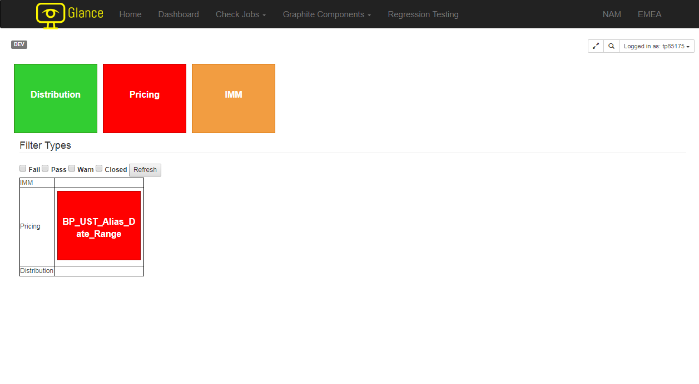
Glance Snapshots
Home page of Glance 2.0: Filters the nodes by their status and displaying those failing by default for immediate attention
3
Text and Layouts
Notes:
One of the problems that the production support team raised with the previous version of Glance was that it was very difficult to browse through the entire On the home page, the default display shows all root nodes, which are the high level categories that each check belongs to, and a table showing all errors failing in the respective category.

Slide 14
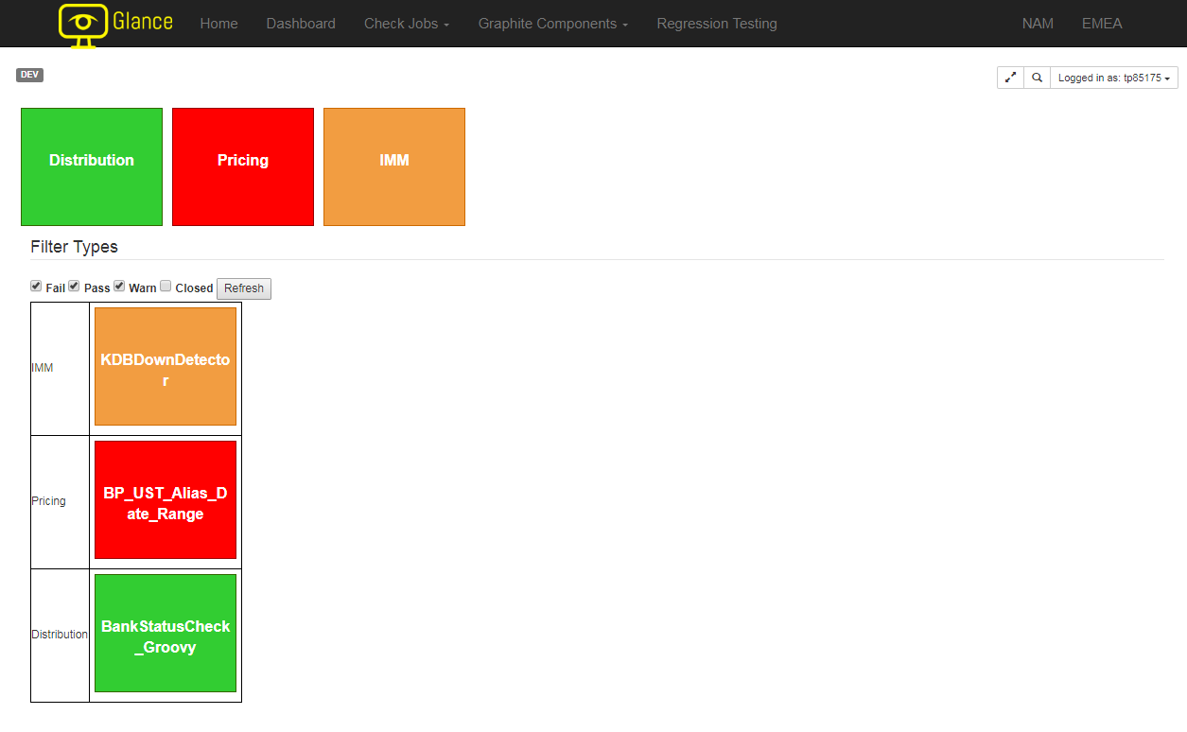
Glance Snapshots
Home page of Glance 2.0: Filters the nodes by their status and displaying those failing by default for immediate attention
3
Text and Layouts
Notes:
One of the problems that the production support team raised with the previous version of Glance was that it was very difficult to browse through the entire On the home page, the default display shows all root nodes, which are the high level categories that each check belongs to, and a table showing all errors failing in the respective category.

Slide 15
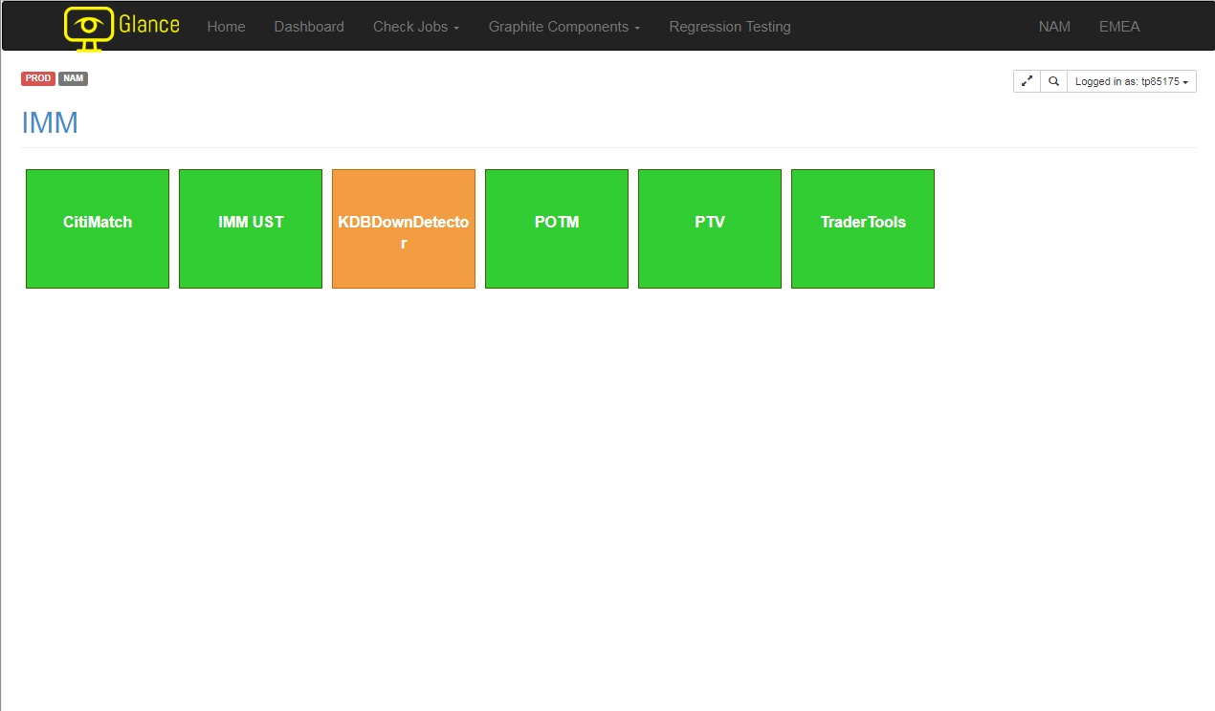
Glance Snapshots
The hierarchy and structure of Glance
3
Text and Layouts
Notes:
Glance is structured as a disconnected and directed graph of system check states – closed, pass, warn, or fail. In essence, the suite nodes in Glance represent these system checks and edges, the internal nodes, represent check state inheritance. For example, on the home page,
For our particular group, the platform usually carries Pricing, IMM, and Distribution. The table below would display all failing tools, if any, within their respective category.

Slide 16
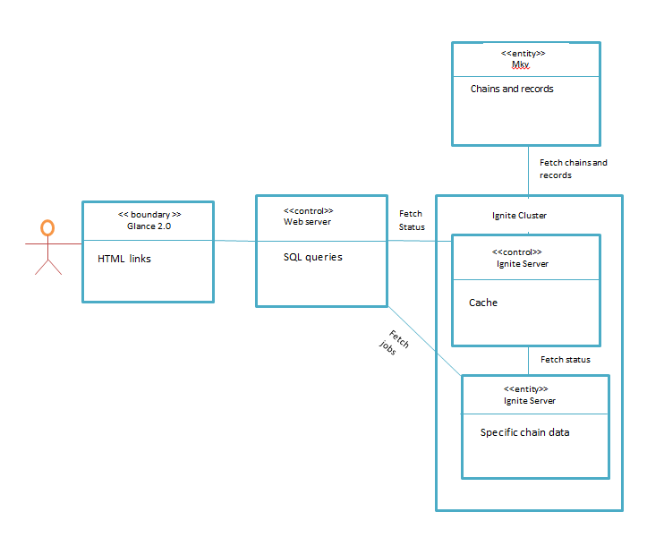
Overall Snapshot
Checking Status

Slide 17
Glance Snapshots
3
Text and Layouts

Slide 19
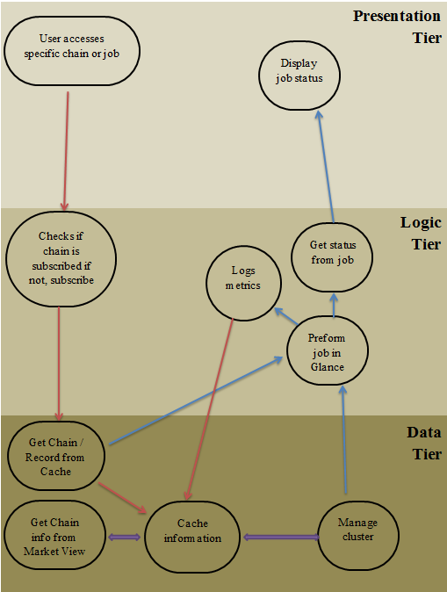
Ignite Snapshots
3
Text and Layouts
Notes:
Vincent:

Slide 20
4. Our Technology

Slide 21









Technology Stack
4

Slide 22
5. Challenges/Solutions

Slide 23
Challenges and Solutions
New software, tools, programming languages
Solution: mentorship from team, external documentations
Translating clients need into feasible products
Solution: working with the experts in the team and regular scrums amongst ourselves
Limited hardware/software
Solution: filtering the amount of data during development environment to avoid stack overflow
Notes:
The first point: When we first came on-board, we were unfamiliar with the designated technologies, which in our case included Apache Ignite for backend and javascript with grails in the front-end. Although we did get a few pointers from our mentors and managers to read up on external documentation prior to the internship, it was still extremely helpful to walk through some of the processes with mentors in person.
The second point: One of the main challenges was to evaluate the different ways to achieve the business requirements set by our clients, which is the production support team. The requirements we received from the production support team were simple and straightforward. They want the general performance to be optimized and scalable; they need the access any information as quickly as possible whenever it is throwing an error. However, understanding how to best display the information to facilitate user access and rearranging the backend database such that it should optimize data fetching performance was a lot more work than we originally thought.
The third point: After we past the point where we proved our point of concept and started testing our system against more data, which was around 12GB, the memory allocated on local machine became insufficient to develop any new changes that we made in the middle-end.

Slide 24
6. Impact

Slide 25
Impact
Usability
Incorporation of SQL syntax for simplicity
Immediate access to critical data
Performance
Increased backend capacity
Rearrangement of the user interface to minimize response time

Slide 26
Questions?

